Slide 1
PRIN: PROGETTI DI RICERCA DI RILEVANTE INTERESSE NAZIONALE – Bando 2022 - Prot. 2022J9Z53N
MILESTONE 4 Assessment of results on decision-making process – Genova 7 luglio 2025
Lessons learned?
The past and future of Italian defense policy

Slide 2
Outline
Il progetto PRIN: struttura, obiettivi, risultati attesi
MILESTONE 4 Decision making process - Unità di Genova

Slide 3
Politica di difesa italiana Un dibattito limitato ma crescente

Slide 4
Il progretto PRIN – Domande di ricerca
What have been the main lessons learned from Italian MOA in the new century?
How and to what extent does the interaction among domestic actors, international drivers and the operational contexts affect the defense policy decision-making process?
In which circumstances and under what conditions may defense policies become contentious and divisive issues among Italian elites and their fellow citizens? Is there any difference in this respect between Italy and other European middle-range powers? How does this elite-mass interplay impact the spectrum of policy choices on MOA?

Slide 5
3 temi chiave per Unità di ricerca id Genova (UNIGE)
The (political and military) lessons learned from Italian MOA;
The drivers and the features of the complex decision-making process behind the operations, and specifically its dynamic interaction with the reality on the ground. Review and analysis. The research aims to trace the mechanisms that led Italian political elites to adopt specific decisions in the deployment and employment of armed forces abroad;
Lessons learnt and military innovation. Under what conditions do Armed Forces successfully promote military innovation? Bargaining power.
(The agenda-related and issue-specific positions on Italy’s defense and security policy of both Italian elites and public opinion based on previous MOA and future defense scenarios)

Slide 6
All the research units will contribute to the analysis of the mechanisms of influence concerning three different “arenas”: a) the political and military – domestic – context, namely, parties, leaders, parliament, armed forces (UNIGE); b) the sub-national (NGOs, stakeholders) and supranational (EU, NATO, UN) actors (UNICT - CASD) and c) the dynamic elite-mass interaction (UNISI).

Slide 7
Risultati attesi dal progetto

Slide 8
Obiettivi

Slide 9
Milestones

Slide 10
Review (👍)
Drivers e meccanismi missioni (in corso)
Lezioni apprese: processo (👍) e analisi (in corso)
Coordinamento e disseminazione (👍)

Slide 11
Review Ruolo 2 livelli. Gap: industria e FFAA

Slide 12
Le Lezioni apprese nella pianificazione della Difesa
Ciclo di Pianificazione della Difesa
Identificazione degli obiettivi capacitivi verso cui tendere
Costruzione del basket capacitivo
Innovazione delle forze
Pianificazione delle forze
Sviluppato tramite
Linee di sviluppo capacitivo della difesa
Trae origine da
Analisi futuri scenari
Esperienze maturate in attività addestrative/Teatro operativo
LEZIONI APPRESE

Slide 13
Paper 2 Under what conditions do Italy intervene in missions abroad? (2025, TBC)
“Dual responsibility” (Payne 2023) verso pressioni esterne e vincoli domestici. Richieste da alleati, coerenza verso norme (e narrazioni) domestiche.
Abbiamo identificato i seguenti meccanismi causali
“Full Commitment” (pressione esterna, coerenza con norme/narrazioni interne) ;
“Reluctant Followership” (pressione esterna ma no coerenza…osserviamo il “tipo” di pressione i pattern della riluttanza: “dampening” and “refuse”)
“Helping abroad” (no pressione esterna; coerenza)
“Under the Radar” (no pressione esterna, no coerenza)
Notes:
.As a middle power strongly embedded in the Western security architecture, Italy is “required” to provide its military contribitution when allies and multilateral organizations ask for support to contrast specific threats or guarantee peace, stability and human rights abroad. In that case, we should mainly look at the type of international pressures and at the level of coherence between the military intervention and the “pacifist and multilateral” norms and narratives shared by Italian public opinion (Battistelli et al 2004; Ignazi et al 2012; Catanzaro and Coticchia 2019). If there is coherence between the pressure from allies and norms (e.g. for multilateral and humanitarian missions), domestic factors are irrelevant. Rather, if such coherence is scarce, or (eventually) if there are no international pressures to intervene, domestic factors are crucial, especially to shape the mission and its features. In case of a clash between international pressures and domestic considerations, we need to look at who asks for Italian contribution (US-led NATO or not). If no requests come from abroad, we should examine how pressures to intervene come from domestic actors.

Slide 14
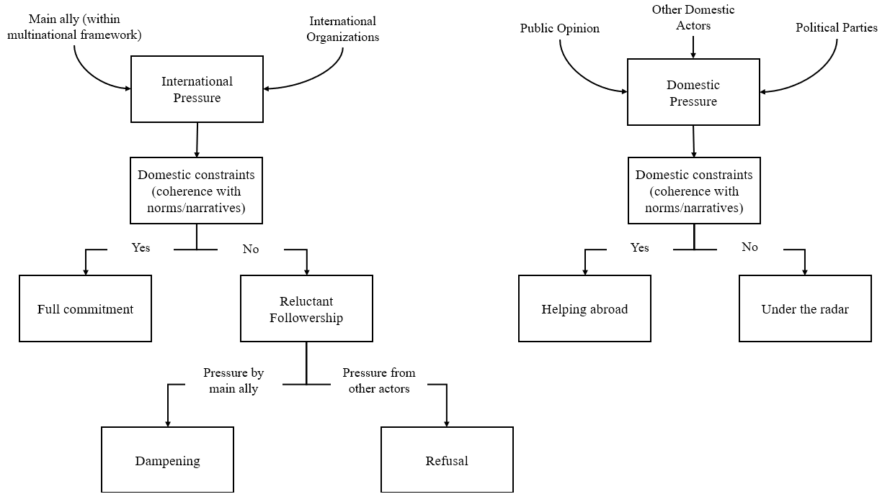

Slide 15
Paper 3: Comfortably numb? Political Alignment and Military Innovation: The Italian Armed Forces in the Post–Cold War Era (SGRI/SISP 25)
What are the drivers of military innovation? What is the impact of operational experience and lessons learnt?
Review (Top down and bottom-up innovation) and gaps
Under what conditions do Armed Forces successfully promote military innovation?
Conditions that foster bargaining power. Alignment
Inductive analysis (SGRI 2025)
Case (plausibility probe): Legge Navale (Sisp 2025)

Slide 16
Sviluppi, ostacoli e prossimi passi
Raccolta empirica: interviste e sondaggi
Stato paper.
Coordinamento tra unità sulla ricerca
Final workshop

