Slide 1
Comfortably numb? Political Alignment and Military Innovation: The Italian Armed Forces in the Post–Cold War Era
Matteo Mazziotti di Celso (Università di Genova) Fabrizio Coticchia (Università di Genova)
https://www.italiandefence.org

Slide 2
Outline
Puzzle, aims, and contribution
Literature review
The case of Italy (I): inductive analysis
A theoretical framework
The case of Italy (II): deductive analysis, «la legge navale»
Conclusions

Slide 3
Political Alignment and Military Innovation in Italy Research Focus and Puzzle
Lively debate on the drivers of military innovation. From top-down analyses to adaptation from the ground (from the War on terror to Ukraine). “The operational dimension as the center of gravity for the military transformation”. Always true?
Innovation as a process with different steps (Horowitz and Pindyck 2023). Political interest in innovation decides on innovation’s implementation (Terhorst 2024). Limited empirical analyses on the conditions that allow such political support
Debate on Italian defense. Italian Armed Forces have transformed since the 1990s, but not uniformly. The Army adapted mostly through operational experience. Yet, Navy and Air Force evolved through strategic-industrial logic and long-term planning. Why do branches innovate differently under the same institutional and strategic environment?

Slide 4
Aims
The paper focuses the interplay between armed forces and political actors.
Drawing on primary and secondary sources (interviews, documents, etc.), the study seeks to understand how and why each branch of the armed forces has evolved in distinct ways. Under what conditions do Armed Forces successfully promote military innovation?
Inductive approach (analysis of the recent transformation of the three services) to develop the teoretical framework that is then assessed – via a deductive approach – in the case of the «Legge Navale».
The manuscript develops a theoretical framework (“alignment”) that advances a set of conditions of successful “armed forces’ bargaining power” (Kadercan 2014), to explain when and why proposals for change are likely to be accepted by political actors.

Slide 5
The article contributes:
First, to the (underdeveloped) literature on Italian defense policy
Second, to the broader debate on military innovation by offering a tool to understand how innovation occurs, focusing on the conditions behind “armed forces’ bargaining power”

Slide 6
Current debate on military innovation
The literature has widely examined “how” and “why” do armed forces innovate. Definitions of innovations and adaptation
First «traditional» top down literature on military innovation: on civil-military relations (Posen, Avant, Zisk), interservice politics (Bacevich; Sapolsky), intraservice politics (Rosen), and organizational culture (Farrell, Kier)
Second wave: bottom up (Grissom). Focus on adaption and lessons from the ground
Existing consensus on: armed forces not as monolithic organizations, innovation and adaptation as dialectical processes, between top down/bottom up and learning/bureaucracy dimensions.
Recent research (Horowitz and Pindyck; Terhorst) of the different “stages” of it: invention, incubation, implementation. Interplay political actors – armed forces.
“We define military innovations as changes in the conduct of warfare designed to increase the ability of a military community to generate power” (Howitz and Pindyck 2023, 99)

Slide 7
Further directions and gaps
Attention on the ways through which lessons learnt results in adaptation. Yet, how do these lessons led to innovation in “peacetime” is still not clear, (empirical cases examined often focus on “ad hoc systems” ). What happens when do services undertake different trajectories – as “bureaucratic organizations” vs “learning organizations” - in era marked by blurring boundaries between war and peace?
The “mediating role of social and political networks” (King 2013) in the interplay with operational and technological factors to develop adaptation and – especially - innovation is often undertheorized. "With the exception of Zisk, scholars have paid less attention to how intraparty political pressures and political ideology have provided the external impetus for innovation” (Bury and Catignani 2019)
Focus on individuals but not on parties at government (FPA). Active civilian actors…what about “passive leaders” and political parties? (e.g., Spain, Marquina and Diaz 2010).
Recent research on the different phases of innovation: But what about empirical analyses on drivers that led political support?
Plus, a traditional limited attention to specific cases (a lot on USA, UK, Israel…but middle powers?)

Slide 8
Innovation and civil-military relations
Drivers of military innovation: politics, ideology and finance rather than military necessity (Bury and Catignani 2019, 701)
Under what conditions do Armed Forces successfully promote military innovation? What are the conditions of a successful “armed forces’ bargaining power”?

Slide 9
Inductive analysis The case of Italy (1st part)
This manuscript looks at the military innovation of armed forces, unpacking the different trajectories of services involved – at different pace – on the field, investigating the interplay of different – civil and military - actors and their interests and preferences.
Exploratory research design. Case of Italy: military activism, variation, constraints (finance, culture)
Sources, semi-structured interviews with retired general officers and defense experts, official documents, parliamentary debates, and specialized defense publications such as Rivista Italiana Difesa, Panorama Difesa, Rivista Militare, Rivista Aeronautica, and JP4

Slide 10
The Army – Operationally Driven Innovation
The Army focused on asymmetric warfare: Somalia, Lebanon, Afghanistan, Iraq.
Innovations driven by deployment needs:
VTLM Lince, Freccia, Centauro, A129 Mangusta.
Counter-IED, light forces, special forces.
Minimal political support for heavy platforms: Ariete tank, Dardo IFV.
No successful “land forces law”; partial failure of Forza NEC.
Result: effective but technologically lagging force.

Slide 11
Navy and Air Force – Strategic and Industrial Drivers
Navy:
Less engaged operationally, but politically successful.
Built broad capabilities: LHDs, frigates, submarines, dual-use framing.
Strong industrial base (Fincantieri) and maritime geography helped secure resources.
Air Force:
Shaped by industrial policy and US ties (e.g., F-35, Typhoon, KC-767).
High-tech systems prioritized over battlefield feedback.

Slide 12
A Theoretical Framework – Political Alignment (I)
Drivers of innovation: threats, culture, civil-military relations, adaptation, emulation and international alliances.
“Rather than spending energy on a grand theory of all military innovation at all times everywhere, we need to focus on specified sets of explanations for some types of innovation under certain conditions” (Laksmana 2017, 348)
Our framework combines organizational theory and party politics to explain how military change depends on political approval.
Scope conditions: focus on civil-mil relations, the requests of transformation by armed forces of a middle power in the phases of incubation and implementation

Slide 13
A Theoretical Framework – Political Alignment (II)
Key Argument: Innovation succeeds when military proposals –- align with governing parties’ interests.
Parties: logic of political survival. Armed forces: resources
Process of alliance-building among key-actors within the wider defence policy community (Zisk)
Conditions of “armed forces’ successful bargaining power”: parties support salient proposed innovation that fits with political landscape, allowing overcoming constraints
Role of individuals and domestic actors (industry)

Slide 14
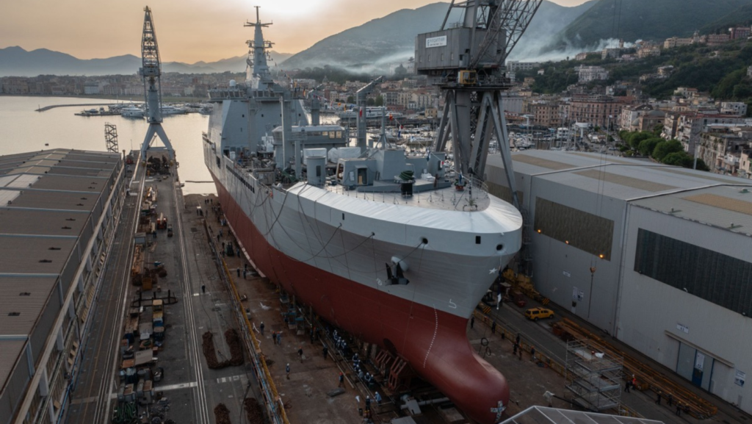
Italian case (2nd part) A plausibility probe
The 2014 “Naval Law”
Puzzling: financial austerity, pacifist public opinion, political reluctance after the failure of “the war on terror”, expensive platforms, limited engagement of the Navy (in comparison to the Army, which still required new assets) in missions abroad, innovation generally linked with “unified” civil-military relations
Alignment political landscape – proposed innovation: advanced narrative on the innovation that fits with the political and cultural context (salient issue, political survival), support by the industry, active innovation entrepreneurs in the decision-making process

Slide 15
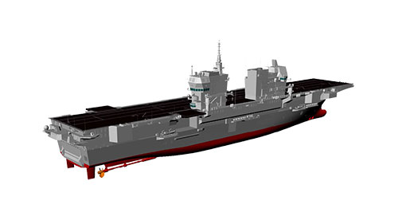
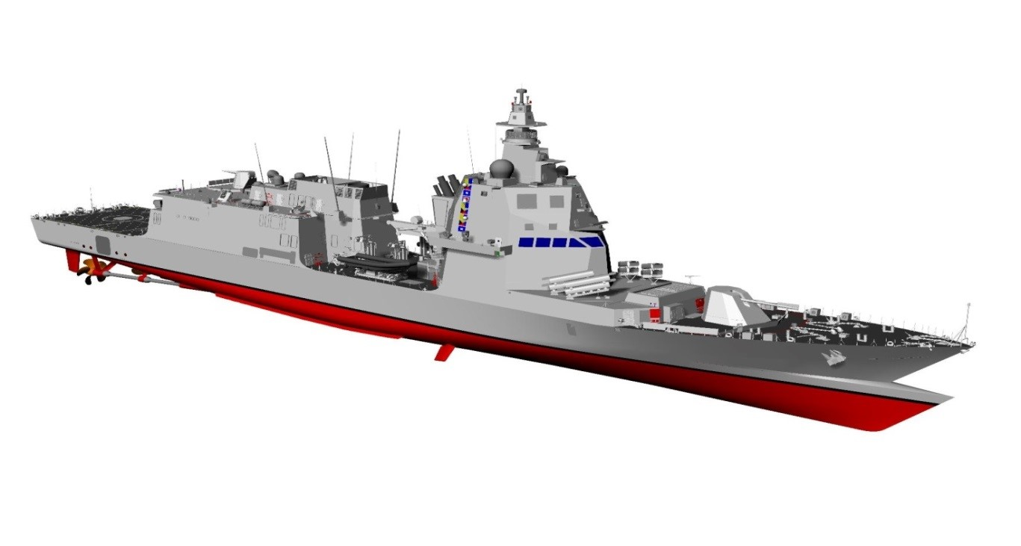
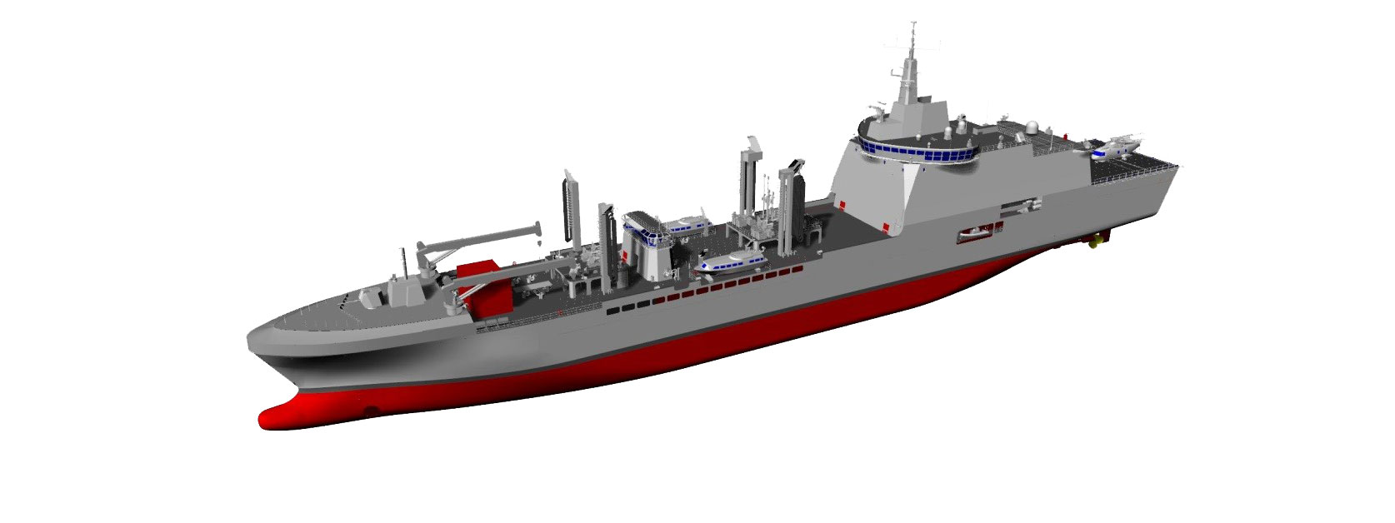
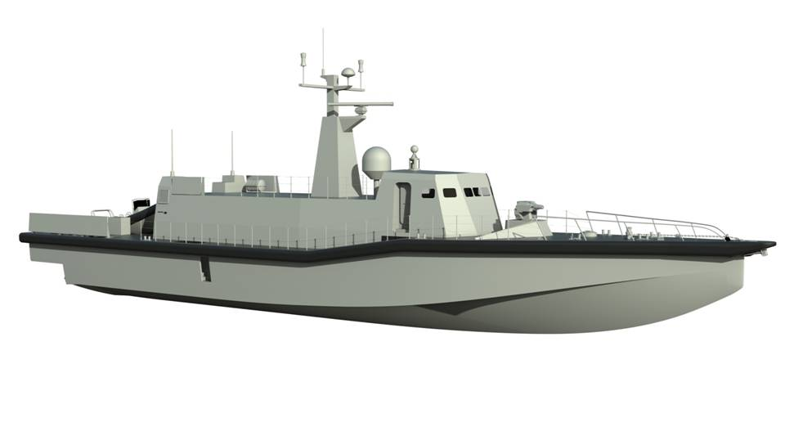
The program
6 x PPA (∼ € 3.500 mln)
TOT: € 5,4 mld
1 x LHD (∼ € 1.171 mln)
1 x LSS (∼ € 376 mln)
2 x UNPAV (∼ € 42 mln)

Slide 16
The exceptional nature of the 2014 Naval Law
Unprecedented in Scope and Timing:
Cost: €5.4 billion—over 25% of the total armed forces budget in 2014 (~€20 billion).
Scale: Authorization of 10 ships (plus 4 optional) in a single act—rare even in Europe.
Relative Need: Despite real underfunding, the Army was more operationally stretched and worse funded.
Political Context:
Rise of the Five Star Movement (25% in 2013 elections), strongly opposed to defence spending.
Economic crisis ongoing: unemployment at 12.7% (highest since 1977).
F-35 program temporarily suspended months earlier.
Remarkably, the Navy secured massive funding and procurement approval despite stronger claims from other services and a politically adverse environment. Why?

Slide 17
The context
International:
US Pivot to Asia → Reduced US presence in MENA.
Rising threats: ISIS in Iraq/Syria & Russia in Ukraine.
NATO (Wales 2014): 2% GDP & 20% procurement pledges.
Domestic (Italy):
Economic crisis: –0.1% GDP growth, 12.7% unemployment, debt at 132%.
Political tension: Rise of M5S (anti-military), fragile Renzi coalition.
Security focus: Record migration flows (170,000 arrivals); Navy central in Mare Nostrum/Mare Sicuro.

Slide 18
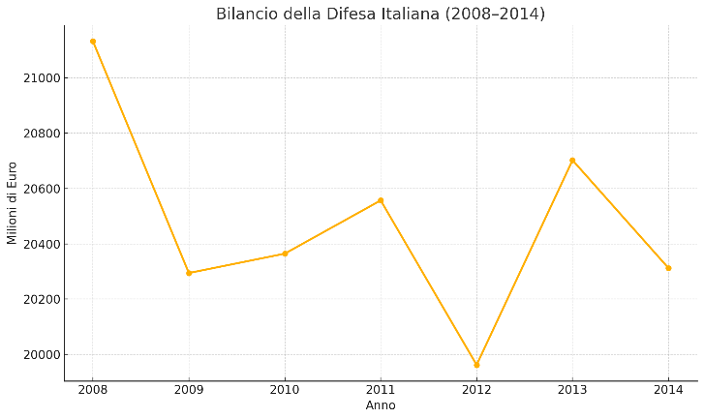
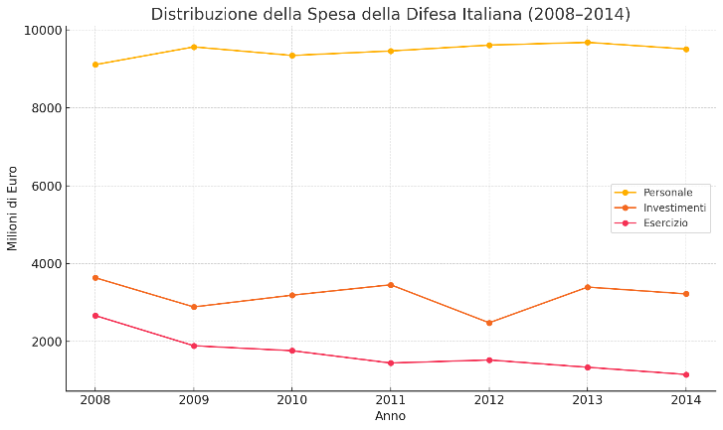
The context
The military policy

Slide 19
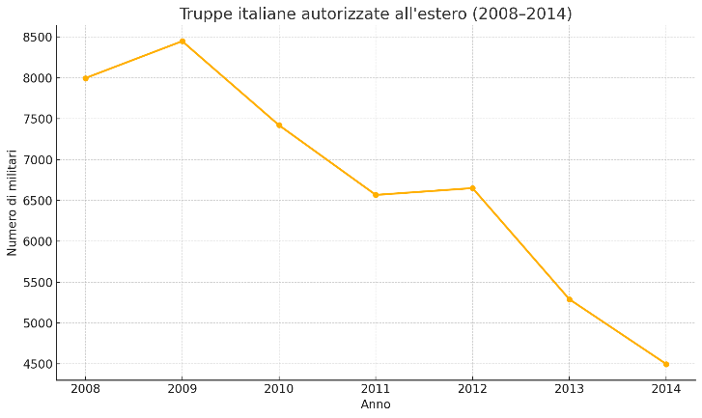
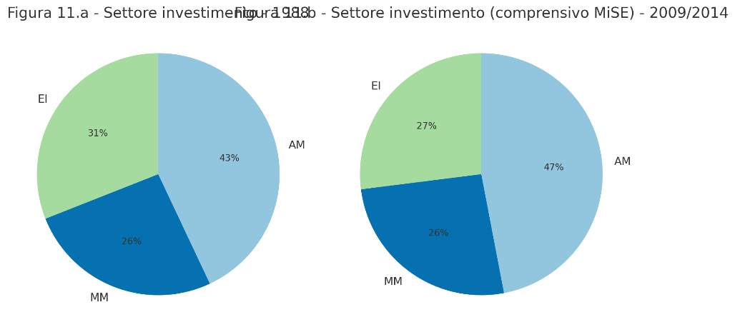
The context
The military policy

Slide 20
The Navy’s bargaining power (1)
The ‘Dual use’ asset
Migration = High Salience Issue
Media focus & public anxiety: migrant arrivals rose from 15 (2012) to 170 (2014).
1 in 3 Italians viewed immigration as a public safety threat.
Operation Mare Nostrum (2013–2014)
Navy-led humanitarian mission; €9M/month cost, widely supported.
Boosted public trust: Navy approval rose to 73.5% in 2015, above police and other services.
Strategic Framing by Navy
Ships presented as dual-use: humanitarian, disaster relief, border control.
Emphasis on civilian functions made opposition politically costly.

Slide 21
The Navy’s bargaining power (2)
Industrial Crisis and Economic Leverage
Fincantieri in Crisis
Drastic demand drop, reliance on welfare subsidies, risk of plant closures.
Navy argued investments would save jobs and reduce welfare spending.
Economic Impact Framing
€5.4B plan: ~50% went to Fincantieri.
Navy estimated 25,000 jobs over 10 years; full shipyard capacity use.
Wider Narrative
Law framed as anti-recession policy.
€5B fiscal return and boost GDP.

Slide 22
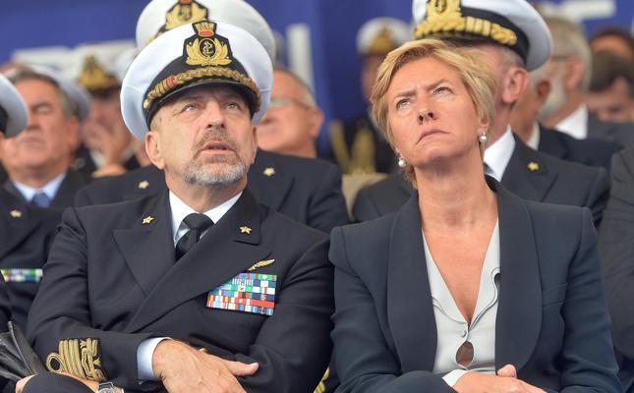
The Navy’s bargaining power (3)
Institutional Alignement
Key Allies in Power
Adm. Binelli Mantelli (Chief of Defence, 2013–2015): Navy background, shaped priorities.
Min. Di Paola (2011–2013): former Admiral; initiated naval renewal plans.
Min. Pinotti (2014–2016): Genoa-based, tied to shipbuilding industry, vocal supporter.

Slide 23
Conclusion
1. Smart Use of Context The Navy exploited migration fears, industrial crisis, and dual-use framing to gain political authorization;
2. Military and Political Actor Success came from building alliances and linking procurement to jobs, security, and public support—not just military needs.

Slide 24
Futher steps
Refine the theoretical framework
Selected cases of «innovation» (and the lack thereof)
Generalization

